Slide 1
Long Term Investing in a Low Return World
Roland Winn
Manager – Investment Analysis
KANGANEWS, NZ DCM SUMMIT 5 AUGUST 2015

Slide 2
Performance since inception
Further details available at www.nzsuperfund.co.nz

Slide 3
Defining our endowments
C3 - Restricted confidential\ SD#1676317 \ PG 3
We can ride-out short term volatility
Genuine contrarian investor
We can invest in private market and illiquid assets
We pay lower tax in some jurisdictions (sovereign status)
Favourably regarded as a potential co-investor and business partner
Long Horizon
Certainty of Liquidity
Operational Independence
Location & Crown Owner

Slide 4
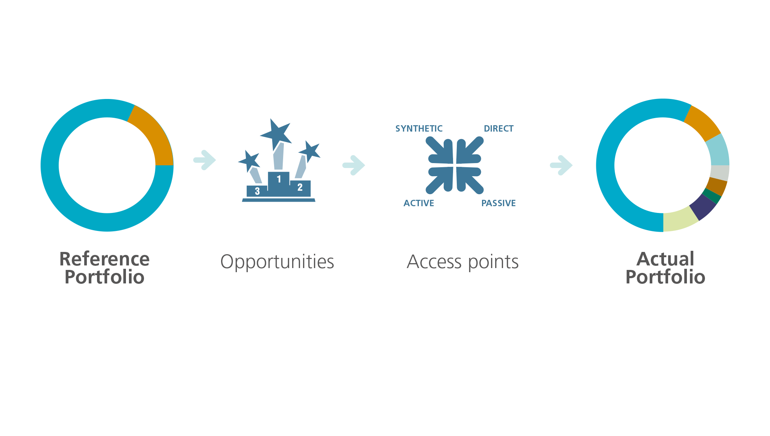
Separate opportunity from access point

Slide 5
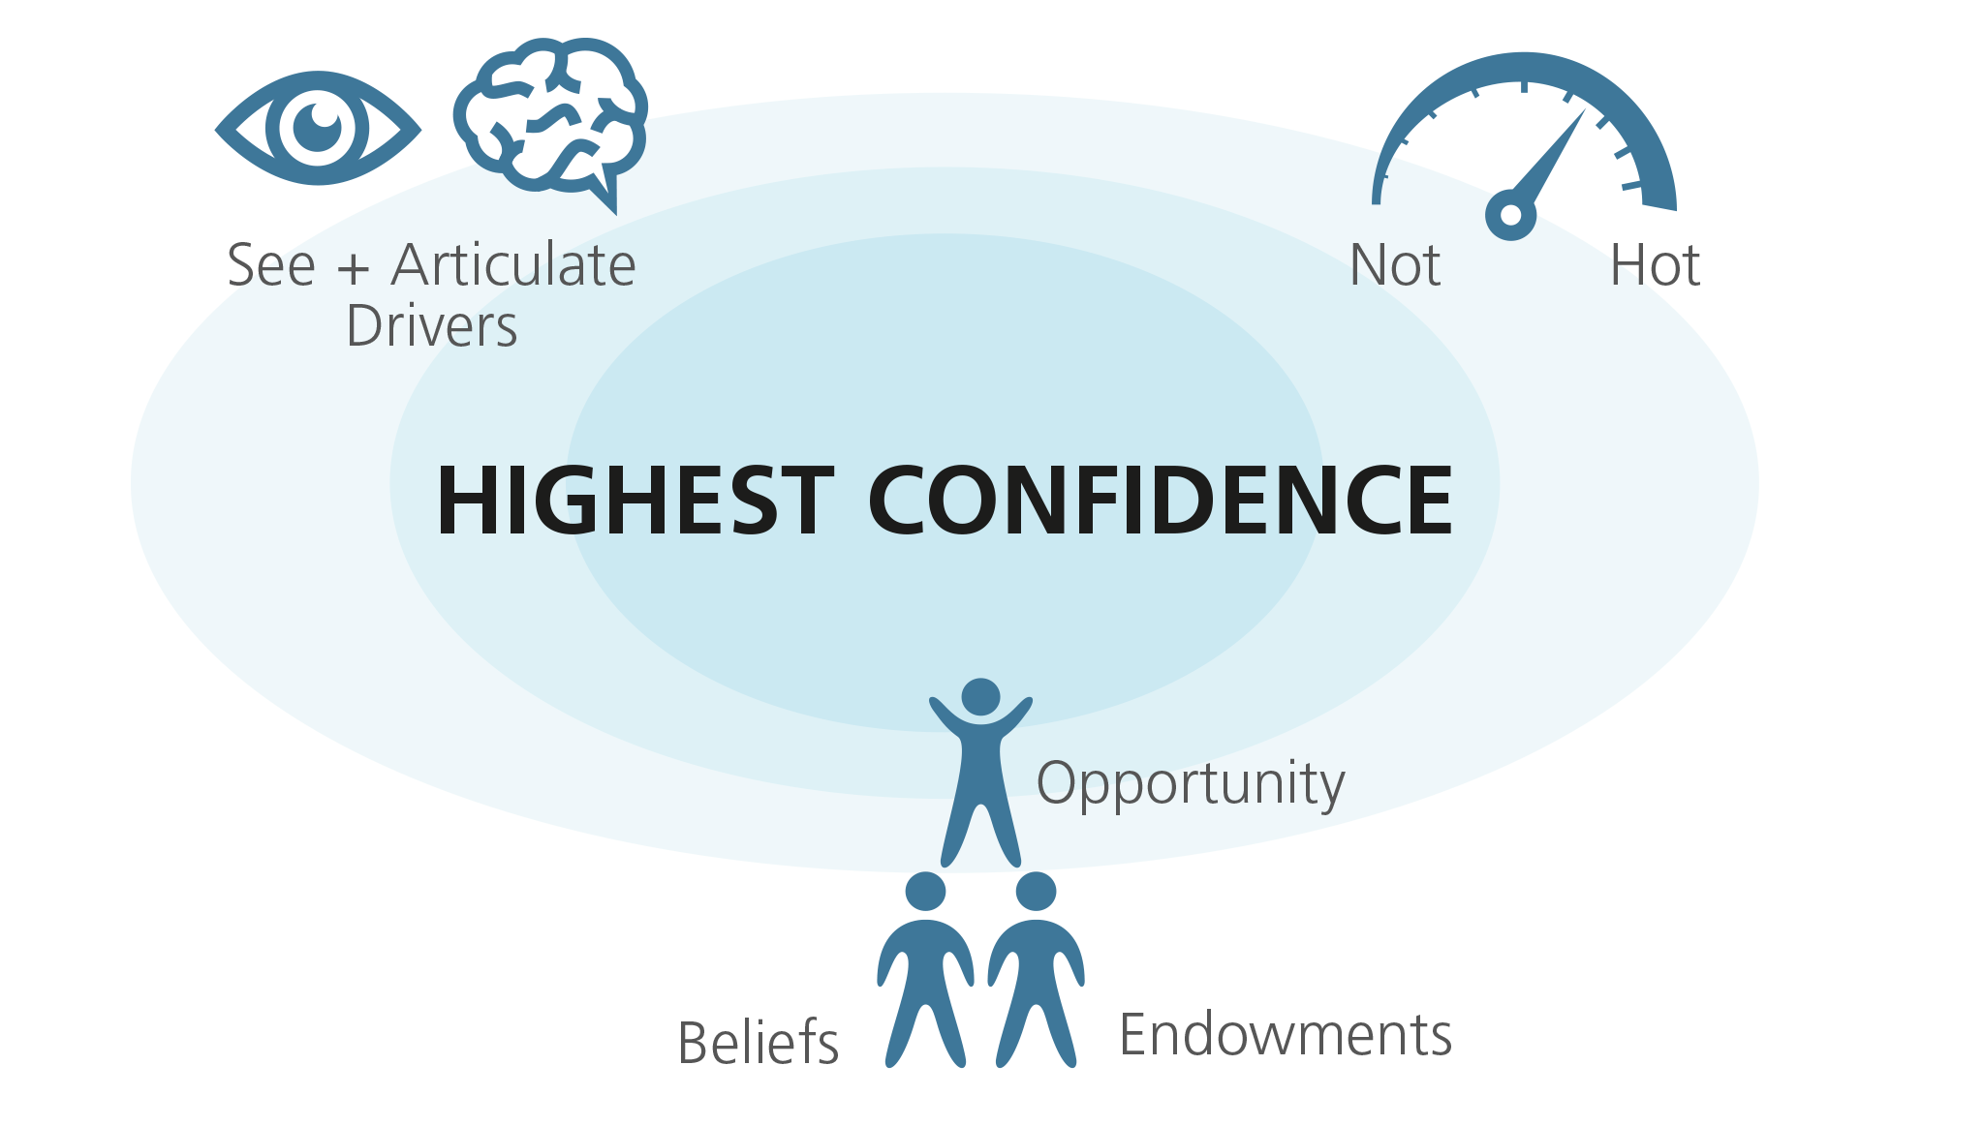

Slide 6
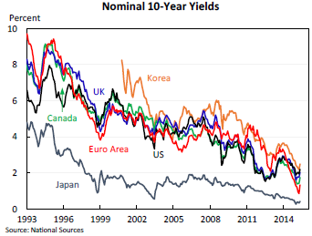
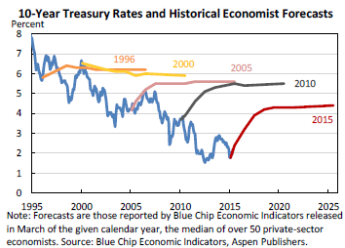
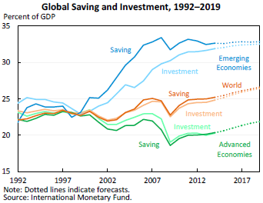
A Surprising Lower for Longer
1
US 30Y Treasury Yields (1975-2015)
2
3
4

Slide 7
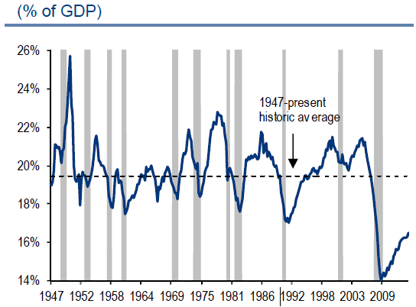
What does main street tell us?
ROA (%)
US Capital Equipment Spend
=
?
Debt to Assets (%)

Slide 8
Market Behaviour
Hard mandate limits, fixed claims & slow-moving expectations almost guarantee distortionary behaviour.
Lower for longer means both growth and rates stay low. What about volatility?
Risk taking behaviour in lower for longer world.
  Moving up the risk spectrum to achieve an absolute return can be self-defeating.
Flight to quality (asset classes, sectors, markets & regions).
  How much should you pay for a good thing?

Slide 9
Opportunities
  Factors - Value vs Growth
Factors - Low beta/low volatility strategies
    Taking advantage of market risk constraints
Emerging Markets

Slide 10
Conclusion
We are endowed with a long horizon and liquidity.
As a long horizon investor we enjoy all the opportunities a short term investor has, plus a lot more.
A stable risk aversion allows us to exploit short term disequilibrium pricing in markets.
Notes:
Our risk tolerance is more stable than the average investor. We have a longer time horizon and as we pointed out when we discussed what a long term investor is, it is an investor who does not have any specific short term liabilities or liquidity demands. That’s us.
We do tend to put on more risk when the market is risk averse and risk is heightened. However, we believe we are being compensated handsomely for this risk because of the significant shifts in risk aversion by the marginal price setter. Equally, we are also prepared to take risk off the table when we believe prices are high.
Aligning our governance with the horizon of the Fund through appropriate incentive structures, ongoing education and open and transparent communication is a necessary element to ensure the success of our long-term strategies.

